Slide 1

CAPSTONE PROJECT-2 RETAIL SALES PREDICTION
BY
SAI NARASIMHA CHARAN THULASI

Slide 2
PROBLEM STATEMENT:
Rossmann operates over 3,000 drug stores in 7 European countries. Currently, Ross*mann store managers are tasked with predicting their daily sales for up to six weeks in advance. Store sales are influenced by many factors, including promotions, competition, school and state holidays, seasonality, and locality. With thousands of individual managers predicting sales based on their unique circumstances, the accuracy of results can be quite varied.
You are provided with historical sales data for 1,115 Rossmann stores. The task is to forecast the "Sales" column for the test set. Note that some stores in the dataset were temporarily closed for refurbishment

Slide 3
WORK FLOW:
Data Collection and Understanding
Data Cleaning and Manipulation
Exploratory Data Analysis
ML Model
Implementation
Feature engineering
And Data Preprocessing
Hypothesis
Testing
So we divide our work flow into following steps

Slide 4
EDA will be divided into following 3 analysis.
1) Univariate analysis: Univariate analysis is the simplest of the three analyses where the data you are analyzing is only one variable.
2) Bivariate analysis: Bivariate analysis is where you are comparing two variables to study their relationships.
3) Multivariate anlysis: Multivariate analysis is similar to Bivariate analysis
but are comparing more than two variables.
Hypothesis Testing is also main component in the project
Feature engineering and Data preprocessing includes such as handling null values,missing values as well as some new table creation,table manupulation etc
Last step is the Machine Learning Model implementation which is most important in our project

Slide 5
DATA COLLECTION Data Description:
Id : an Id that represents a (Store, Date) duple within the test set
Store : unique Id for each store
Sales : he turnover for any given day (this is what you are predicting)
Customers : the number of customers on a given day
Open : an indicator for whether the store was open: 0 = closed, 1 = open
StateHoliday : indicates a state holiday. Normally all stores, with few
exceptions, are closed on state holidays. Note that all schools
are closed on public holidays and weekends. a = public holiday,
b =Easter holiday, c = Christmas, 0 = None
SchoolHoliday : indicates if the (Store, Date) was affected by the closure of
public schools
StoreType : differentiates between 4 different store models: a, b, c, d
Assortment : describes an assortment level: a = basic, b = extra, c = extended

Slide 6
DATA COLLECTION
CompetitionDistance : distance in meters to the nearest competitor store
CompetitionOpenSince[Month/Year] : gives the approximate year and month of the time the nearest competitor was opened
Promo : indicates whether a store is running a promo on that day
Promo2 : Promo2 is a continuing and consecutive promotion for some stores: 0 = store is not participating, 1 = store is participating
Promo2Since[Year/Week] : describes the year and calendar week when the store started participating in Promo2
PromoInterval : describes the consecutive intervals Promo2 is started, naming the months the promotion is started anew. E.g. "Feb,May,Aug,Nov" means each round starts in February, May, August, November of any given year for that store

Slide 7
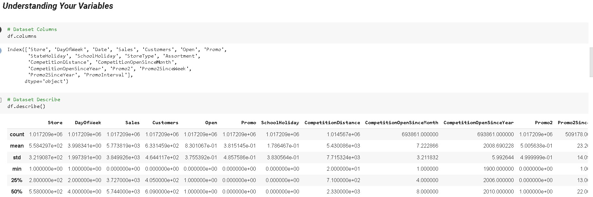
Understanding Your Variables
Here we show the columns of the dataset and describe the dataset

Slide 8
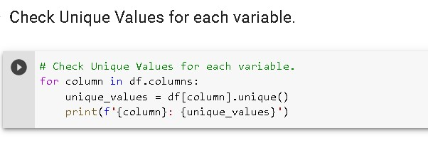
Data manipulations
Here we check the null values of the dataset
And print the unique values

Slide 9
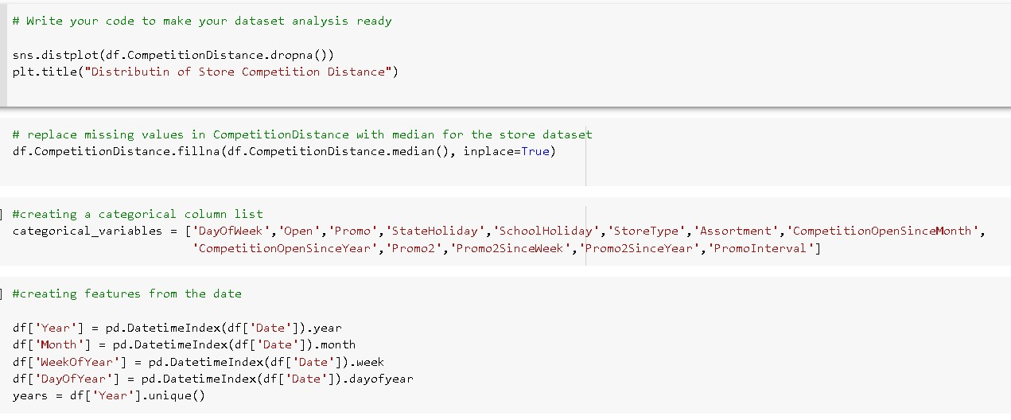
DATA WRANGLING
1st we make your dataset analysis ready
Replace missing values in competition distance with median for the store dataset
And then create a Categoreical column list
Now we creating the features from the data

Slide 10
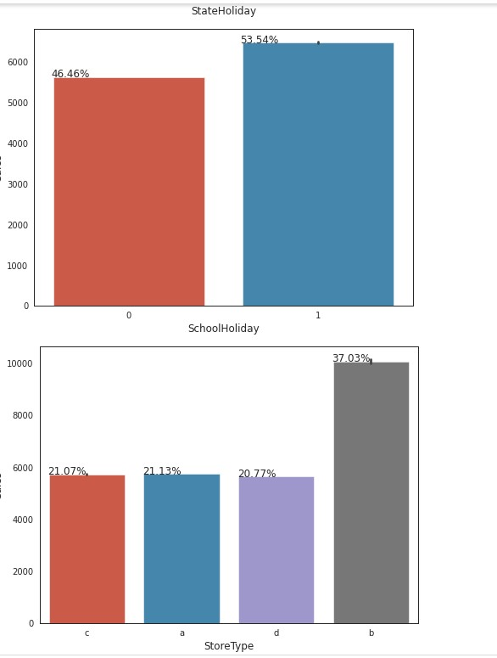
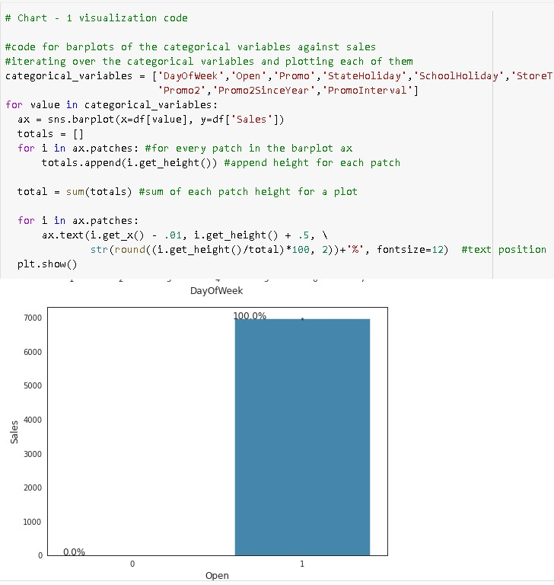
Data Vizualization, Storytelling & Experimenting with charts
Chart-1:

Slide 11
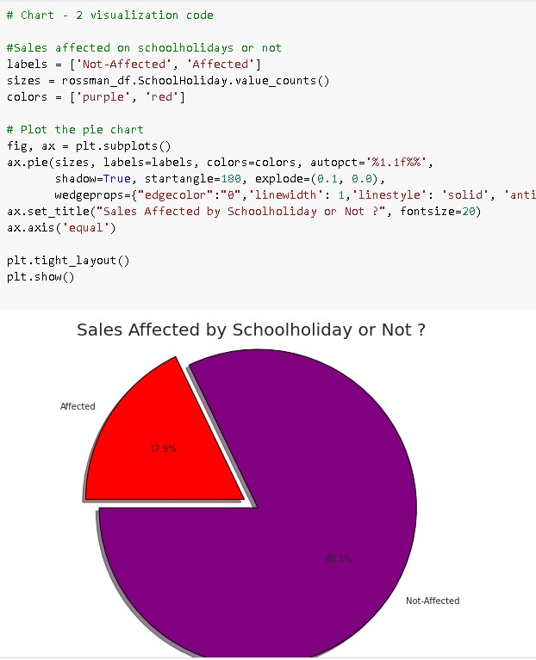
Data Vizualization, Storytelling & Experimenting with charts
Chart-2:
In This To know the how many sales afffected by schoolholiday.
82.1% sales are not affected and only 17.9% sales is affected because of schoo holiday.
Yes definitely because we will able to know to improve on each areas.It is positive signs that the most of sales is not affected only some % affected.

Slide 12
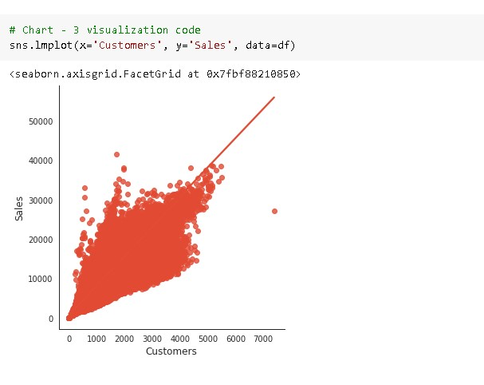
Data Vizualization, Storytelling & Experimenting with charts
Chart-3:
To know the customer vs sales relation.
As we can see their is linear relationship between customers and sales as customers increasing sales also increasing
it is positive signs that customers increasing then sales also increasing

Slide 13
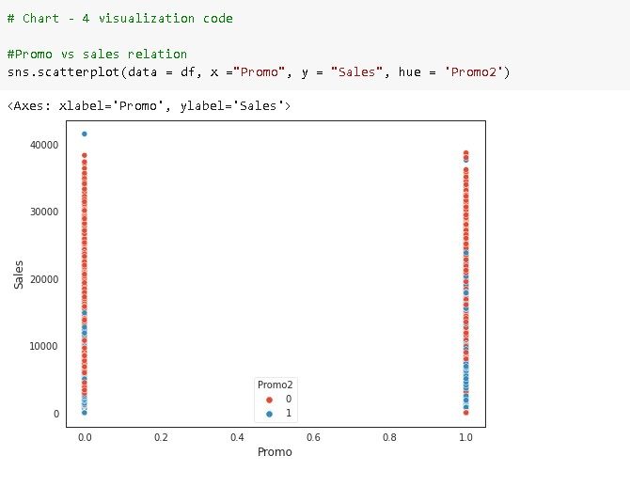
Data Vizualization, Storytelling & Experimenting with charts
Chart-4:
To know the promo vs sales relation.
Here we can see that if their is no promo the sales is very less and if promo running their the sales is high.
it creates very much impact because we can observe that if promo using their is sales also increasing and if promo not using it is negative impact on sales

Slide 14
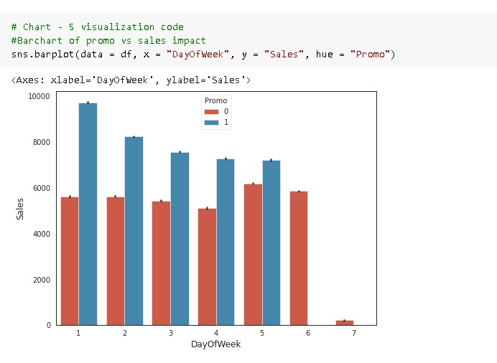
Data Vizualization, Storytelling & Experimenting with charts
Chart-5:
In this To know the exact diffrence of sales when promo using and not using.
Their is large diffrence on monday and it is decreasing day by day and on sunday their is no sales so it shwing less.
it is actually not we can say because of promo only sale is increasing we should focus on increasing sales without promo also or we should use promo everyday

Slide 15
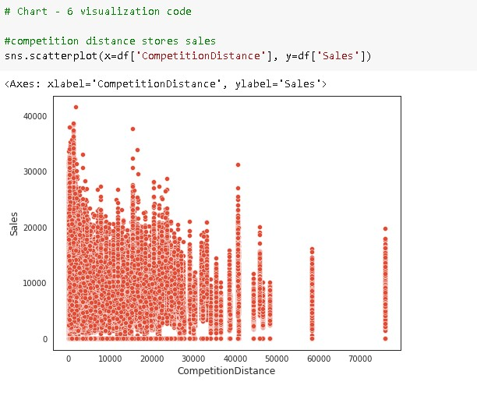
Data Vizualization, Storytelling & Experimenting with charts
Chart-6:
In this know the competition stores distance and sales.
From the above scatter plot it can be observed that mostly the competitor stores weren't that far from each other and the stores densely located near each other saw more sales.
Yes we are able to know the competitor stores and their sales make strategies according to it.

Slide 16
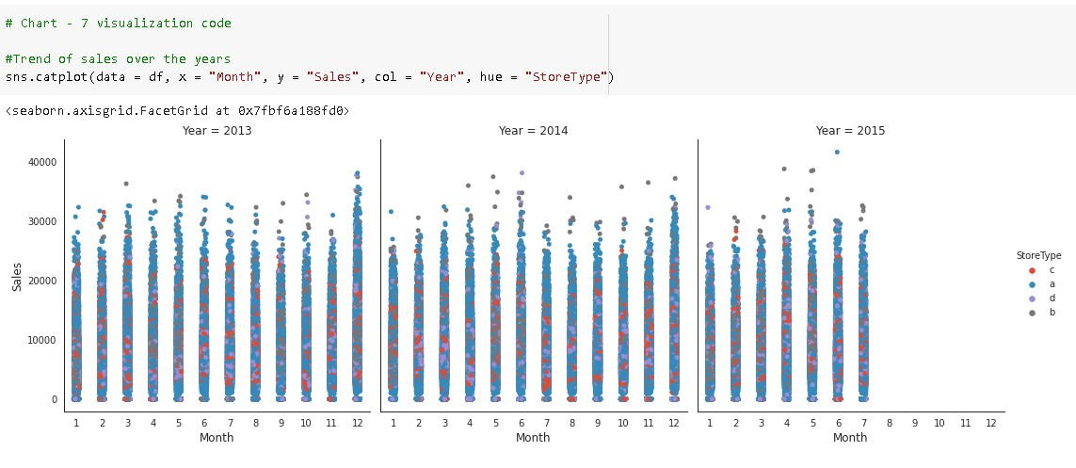
Data Vizualization, Storytelling & Experimenting with charts
Chart-7:
In his we know the trend of sales over the years.
In 2013 and 2014 their is some increasing in the sales but in 2015 their is some decreasing in trend of sales over the months.
It showing some negative growth in last year it should be some improve

Slide 17
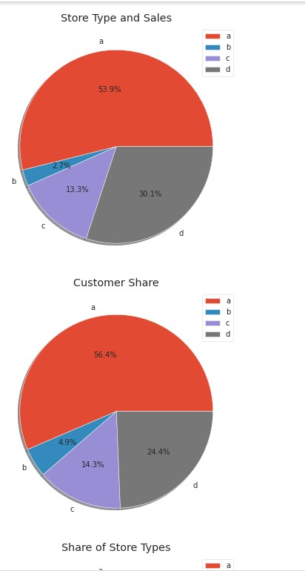
Data Vizualization, Storytelling & Experimenting with charts
Chart-8:
In this the Storetype and Sales,Customer Share,Share of Storetype.
A bar plot represents an estimate of central tendency for a numeric variable with the height of each rectangle. Earlier it was seen that the store type b had the highest sales on an average because the default estimation function to the barplot is mean.
But upon further exploration it can be clearly observed that the highest sales belonged to the store type a due to the high number of type a stores in our dataset. Store type a and c had a similar kind of sales and customer share.

Slide 18
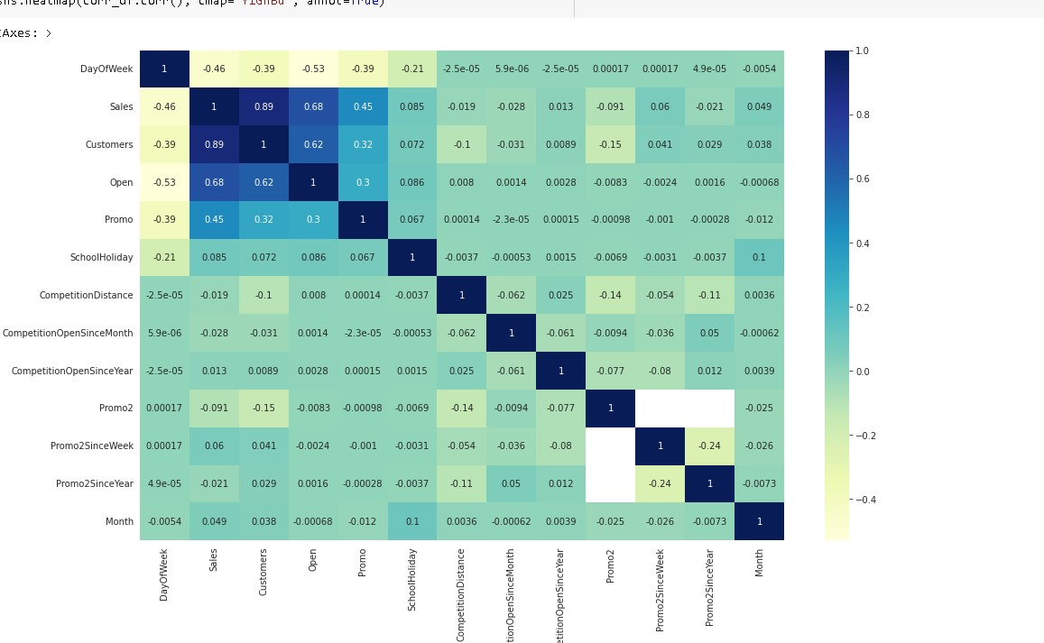
Data Vizualization, Storytelling & Experimenting with charts
Chart-9:

Slide 19
Hypothesis Testing
1. Hypothesis: Stores located closer to competition have significantly lower sales than stores located further away.
2. Null hypothesis: There is no significant difference in sales between stores located closer to competition and stores located further away.
3. Alternative hypothesis: Stores located closer to competition have significantly lower sales than stores located further away.
4. To test this hypothesis, we can perform a two-sample t-test between the sales of stores located within 10 kms of competition and stores located further away. We can set a significance level of 0.05.
5. If the p-value is less than the significance level (0.05), we can reject the null hypothesis and conclude that stores located closer to competition have significantly lower sales than stores located further away.
6. Otherwise, we fail to reject the null hypothesis and conclude that there is no significant difference in sales between the two groups.

Slide 20
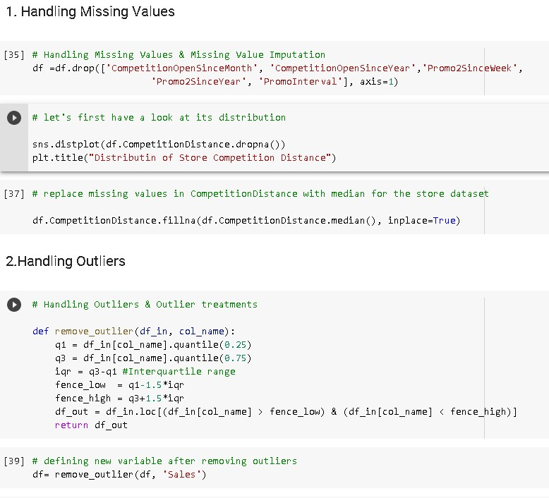
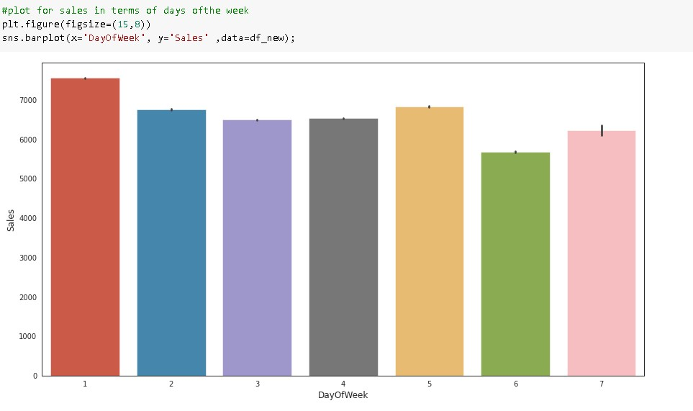
Feature Engineering & Data Pre-processing

Slide 21
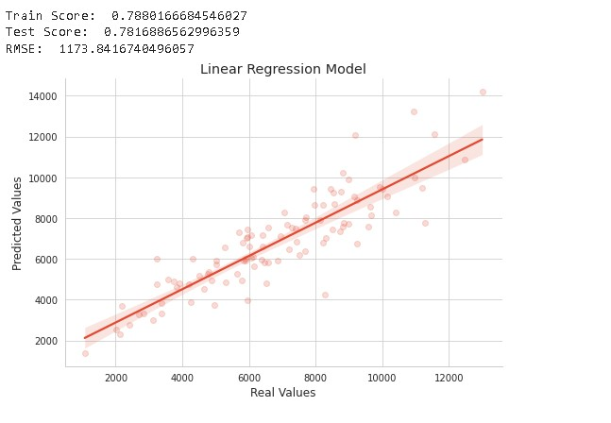
ML Model Implementation
The linear regression model is a simple and commonly used algorithm for predicting numerical values based on a set of input features.
The model's performance is evaluated using the R-squared score, which measures the proportion of the variance in the target variable that can be explained by the model. In this case, the R-squared score on the training set is 0.7812, which indicates that the model explains 78.12% of the variance in the target variable on the training set.

Slide 22
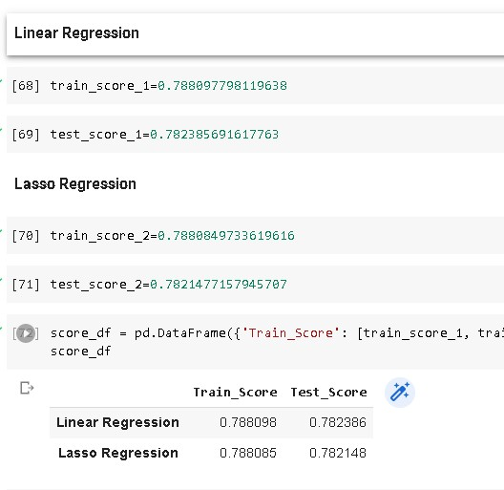
Conclusion
The MSE and R2 score are commonly used evaluation metrics for regression models. In this case, the Linear Regression and Lasso Regression models have very similar performance, with the Lasso Regression model having a slightly lower MSE and a slightly higher R2 score.
The mean squared error (MSE) measures the average squared difference between the predicted and actual values, where a lower MSE indicates better performance. The R-squared (R2) score measures the proportion of the variance in the dependent variable that is predictable from the independent variables, where a higher R2 score indicates better performance.

